Slide 1










Coffee-Exploration
THE DATA ANALYSIS AND VISUALIZATION BOOT CAMP
TEXAS MCCOMBS SCHOOL OF BUSINESS
Project 4 Analytics Team:
Divya Anup
Prashant C
Julie Ramsey
Meera Vanmali

Slide 2


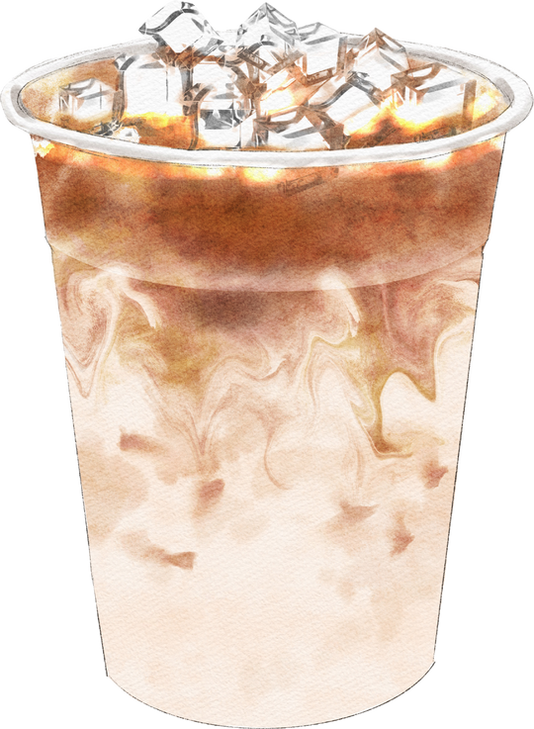

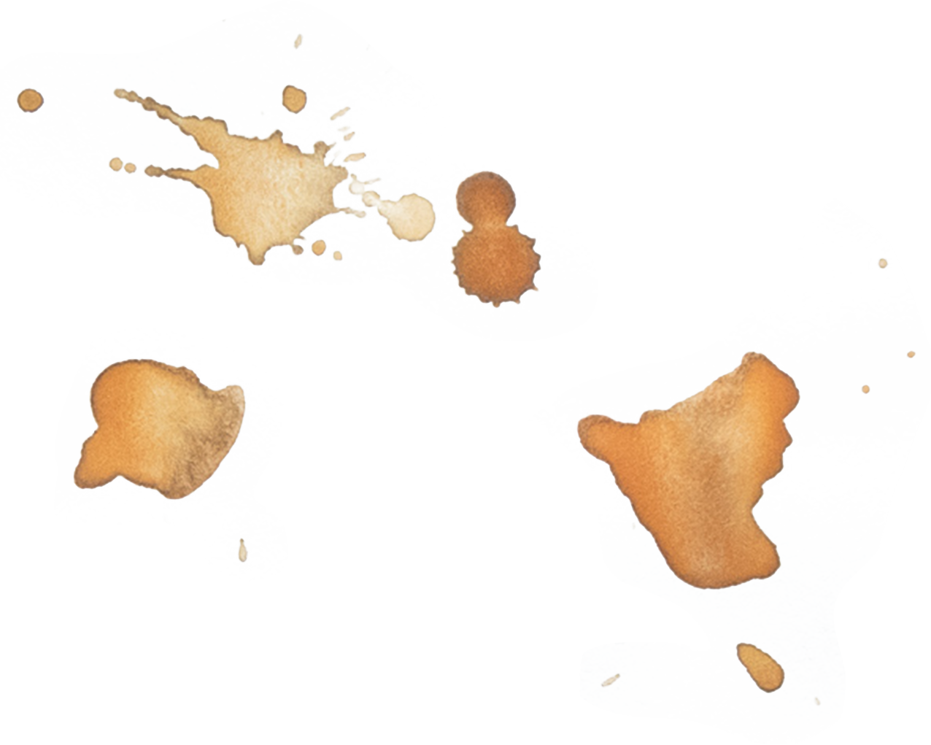
Introduction
Coffee Varieties
Importance of Coffee Ratings
Challenges in Selecting Coffee

Slide 3

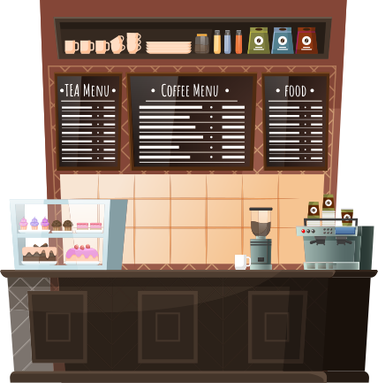
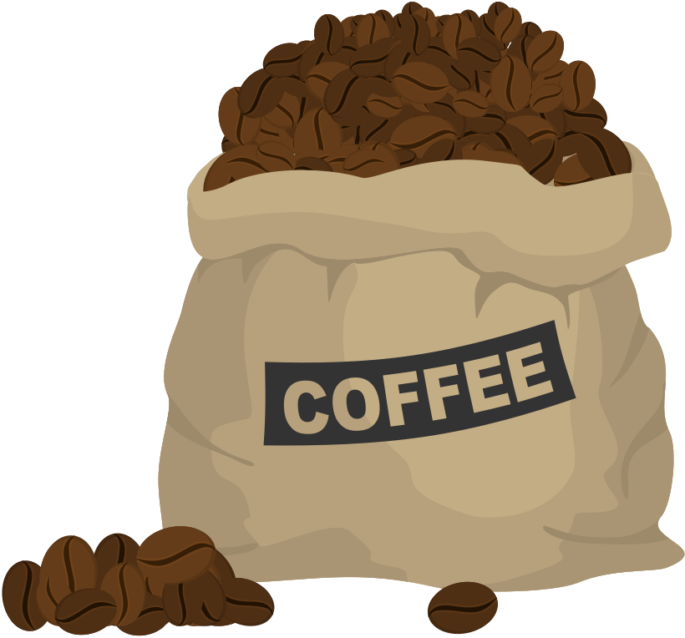
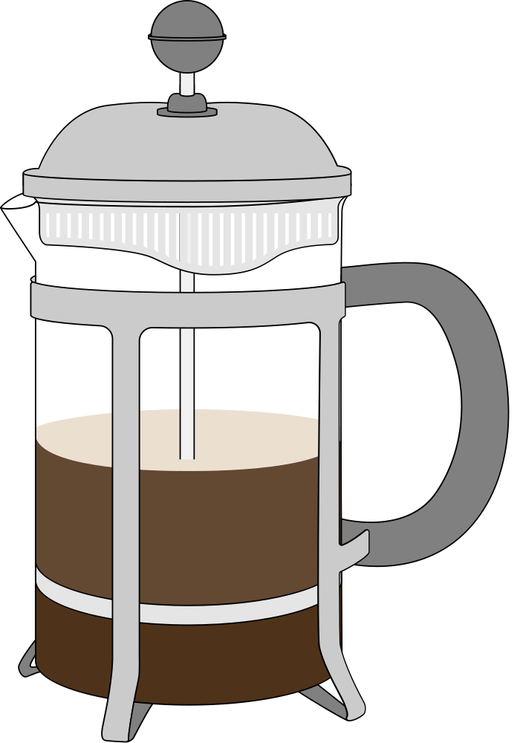


Topic Outline
1
Introduction & Objectives
2
Dataset Overview
3
Background
4
Limitations & References

Slide 4


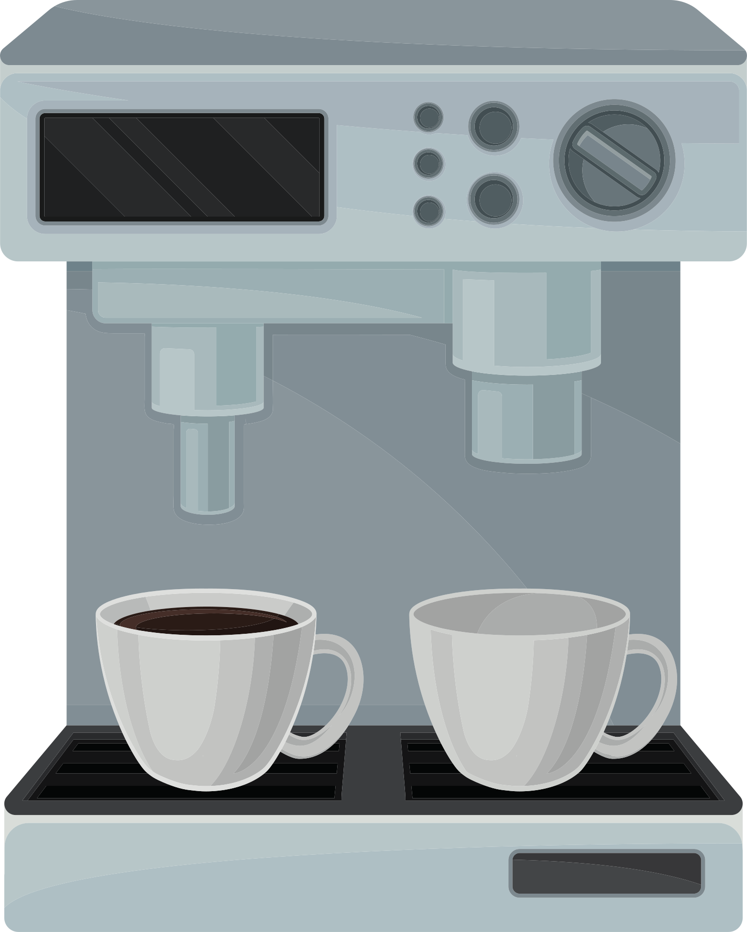



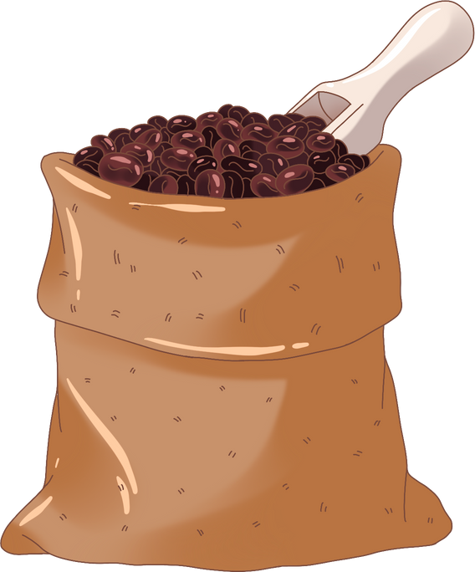
Objectives
Develop an Interactive Coffee Recommendation Model
Enhance User Experience through Data Visualization
Ensure Data Integrity and Consistency
Leverage Machine Learning for Accurate Predictions

Slide 5

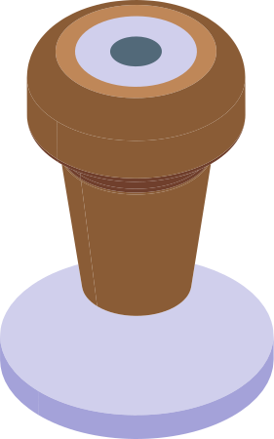



Data Set Overview
Source: Coffee Reviews.com, capturing detailed information on various coffee types.
Data Cleaning:
Cleaned to handle missing values, standardize costs to US dollars per 12 ounces, normalize weights from grams to ounces.
Text data was processed by removing stopwords, punctuation, and converting text to lowercase for consistency.
Data Structure: The final dataset is structured to include key variables such as:
Cost (standardized to USD per 12 oz)
Origin (country of origin)
Roast Level (light, medium, dark)
Description (processed textual data)
Ratings (Aroma, Acid, Body, Flavor, Aftertaste on a 0-20 scale)

Slide 6



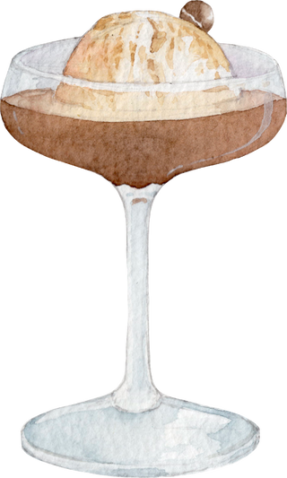





Background
Coffee Collection: Handpicked at peak ripeness in mountainous regions. Only the best, ripe cherries selected for quality.
Bean Processing: Wet process: fermentation removes pulp; beans are washed to reveal green beans. Beans dried in the sun.
Roasting Process : Roasting transforms green beans into aromatic brown beans. Roasting unlocks flavors from light and fruity to deep and smoky.
Brewing a Perfect Cup Beans ground to match brewing method—fine for espresso, coarse for French press. Hot water extraction brings out rich flavors and aromas, crafting the perfect cup.

Slide 7


Most Common Coffee Tasting Descriptions
Aroma
Acidity
Body/Mouthfeel
Flavor
Sweetness
Finish/Aftertaste

Slide 8

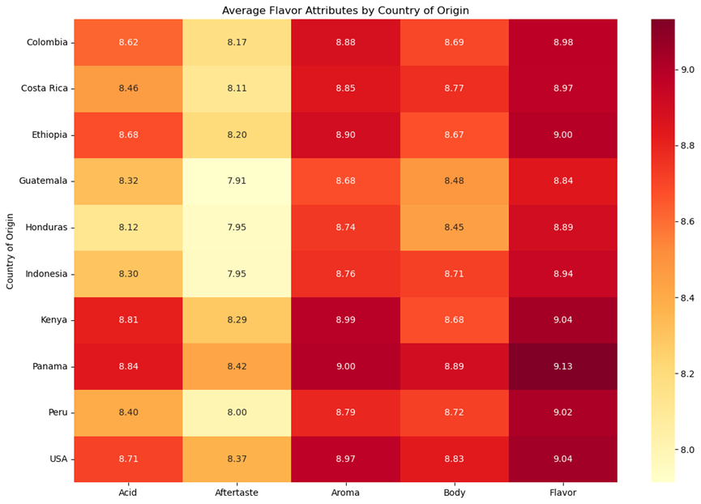

Slide 9

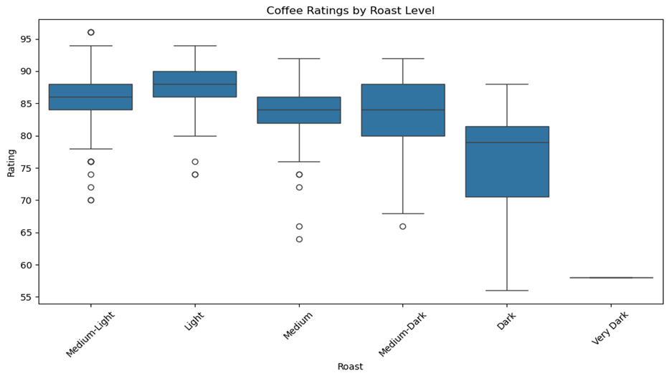

Slide 10

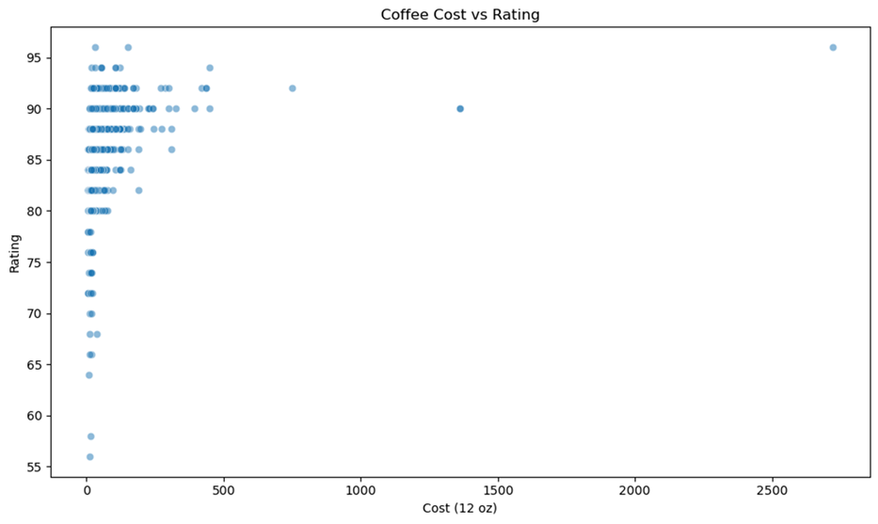

Slide 11

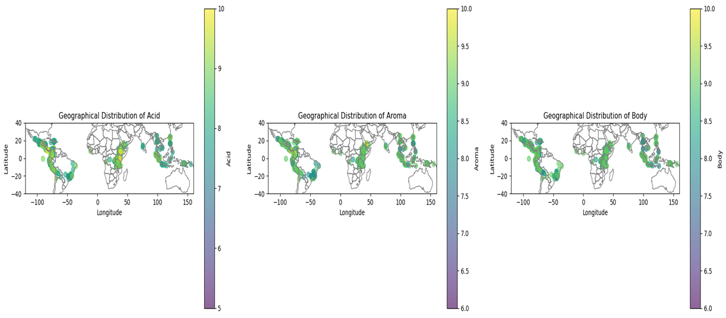

Slide 12

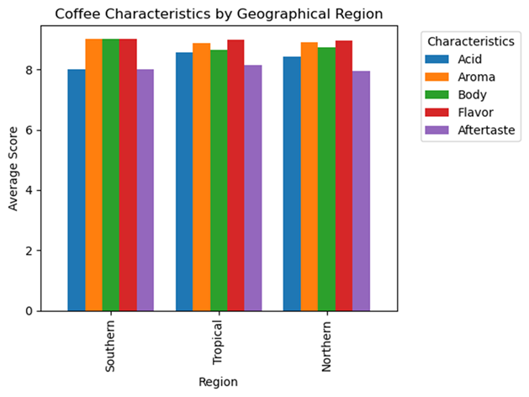

Slide 13
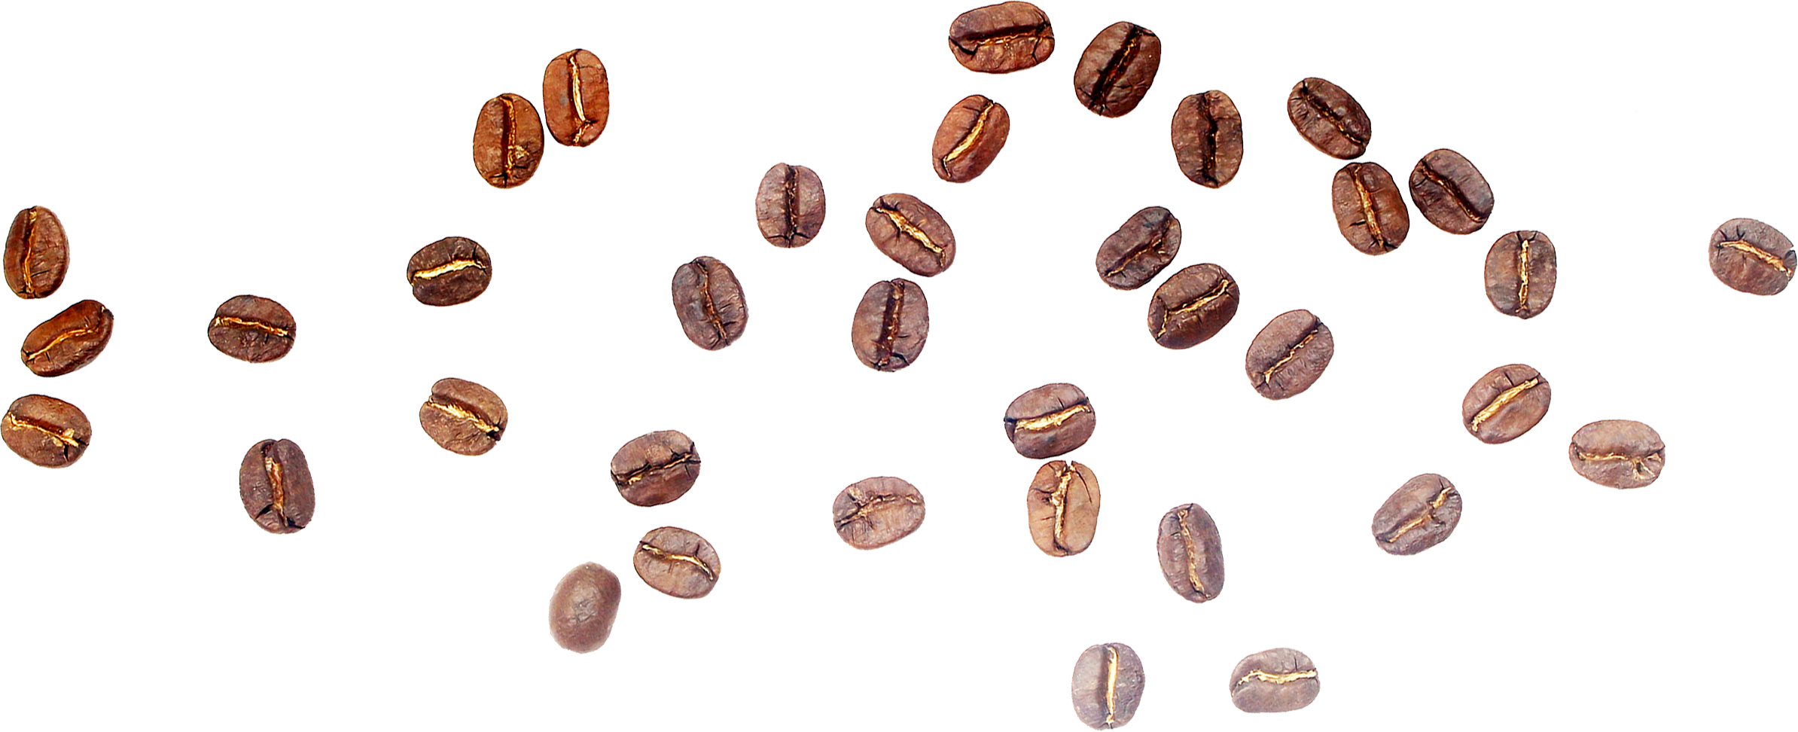

COFFEE MAP

Slide 14
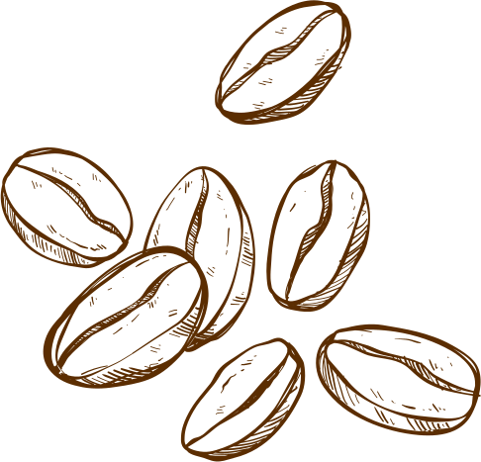

Machine Learning Model
We used a Random Forest Regressor, which combines multiple decision trees to predict coffee ratings.
The model was wrapped in a pipeline for consistent preprocessing.
Baseline Model: Root Mean Squared Error (RMSE) - 0.51
Model Tuning:
Varying parameters - Trees: 50, 100, and 150,
Depth: 5 and 10,
Bins: 32 and 64,
InstancesPerNode: 1 and 2.
RMSE - 0.21 to 0.56
Performance after Interaction terms:
After tuning, the best model achieved an RMSE of 0.39, indicating strong predictive accuracy and a good fit with the test data.

Slide 15


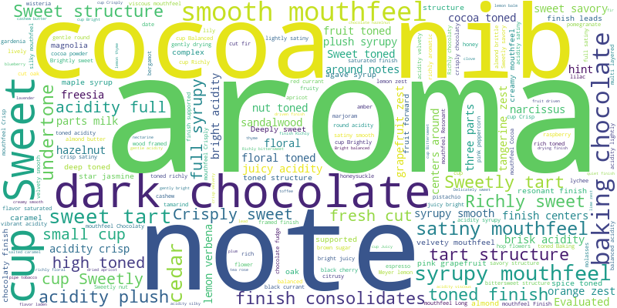

Word Cloud

Slide 16
Limitations, Improvements, and Future work:
Data Limitations:
We faced issues with inaccurate geocoding when mapping coffee origins due to multiple countries listed in a single column. This led to incorrect coordinates, underscoring the need for clean, well-structured data in location-based analysis.
Improvements:
We plan to enhance the model by incorporating additional data sources, such as reviews from other platforms, to better represent lower-rated coffees. We'll also manually validate geocoded locations, especially for coffees with multiple origins, to improve data accuracy and prediction reliability.
Future Work:
Sustainability Scoring: Introduce a sustainability score for each coffee variety, taking into account factors like fair trade certification, organic farming practices, and environmental impact.
Consumer Behavior Over Time: Conduct a longitudinal study to analyze how consumer preferences evolve over time, and adjust the recommendation algorithm to reflect these changes.

Slide 17
Key Takeaways
Conclusion:
The Random Forest model, optimized through hyperparameter tuning, achieved an RMSE of 0.3948, indicating strong predictive accuracy for coffee ratings.
This result demonstrates the model's reliability and effectiveness in capturing key patterns within the data. Further improvements could enhance accuracy, but the current model provides a solid foundation for predictive analysis.
Takeaways:
Data Quality and Preparation are Crucial
Model Tuning Improves Accuracy
Cross-Validation Ensures Robustness and reduces the risk of overfitting.
There is potential for Further Improvement such as exploring additional features, trying alternative algorithms, or further refining the current model.
The model's ability to predict coffee ratings has practical implications, such as helping consumers find the best coffee based on their preferences and assisting roasters in understanding factors that influence ratings.

Slide 18
References
Coffee Terminology Retrieved from hermonoscoffeeroasters.com
Data Source Retrieved from coffeereview
Inspiration and partial code Retrieved from kaggle/coffeescraping
Geoapify Geocoding and Mapping API: Geoapify. (2024).
OpenAI. (2024). ChatGPT (Version GPT-4).

Slide 19
Thank you for listening!
PLEASE DON'T
HESITATE
TO ASK
ANY QUESTIONS!

